Slide 1
Country Travel Store
Phase IV Presentation
Analysis and Design By: Matthew Pederson and Ryan Chen

Slide 2




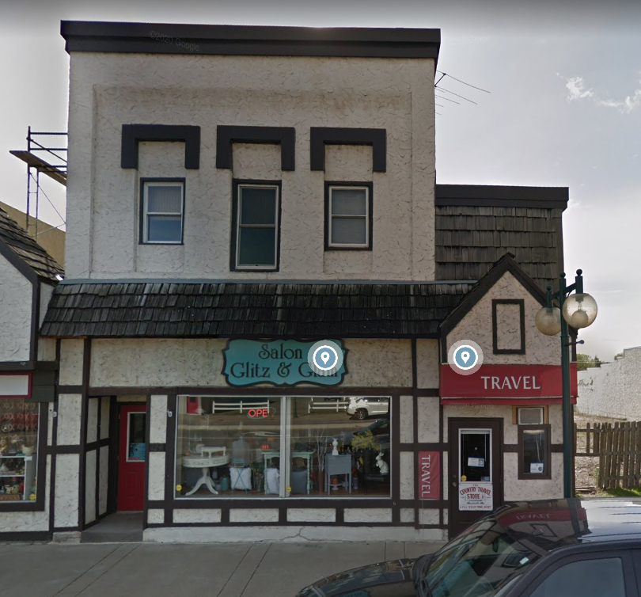
Overview
Country Travel Store is a small travel agency owned by my grandmother for over 30 years. She started the company, and they have been based out of Monticello, Minnesota for the duration of their existence.

Slide 3
Analysis
When deciding what to do for a project for The Country Travel Store it was relatively easy, because right away in the interview they brought up that they use an all-paper filing system broken up by category (5 categories). This set the project in motion because we quickly explained why that was not efficient and they then asked us if we could design a system that would fix their paper problem.

Slide 4
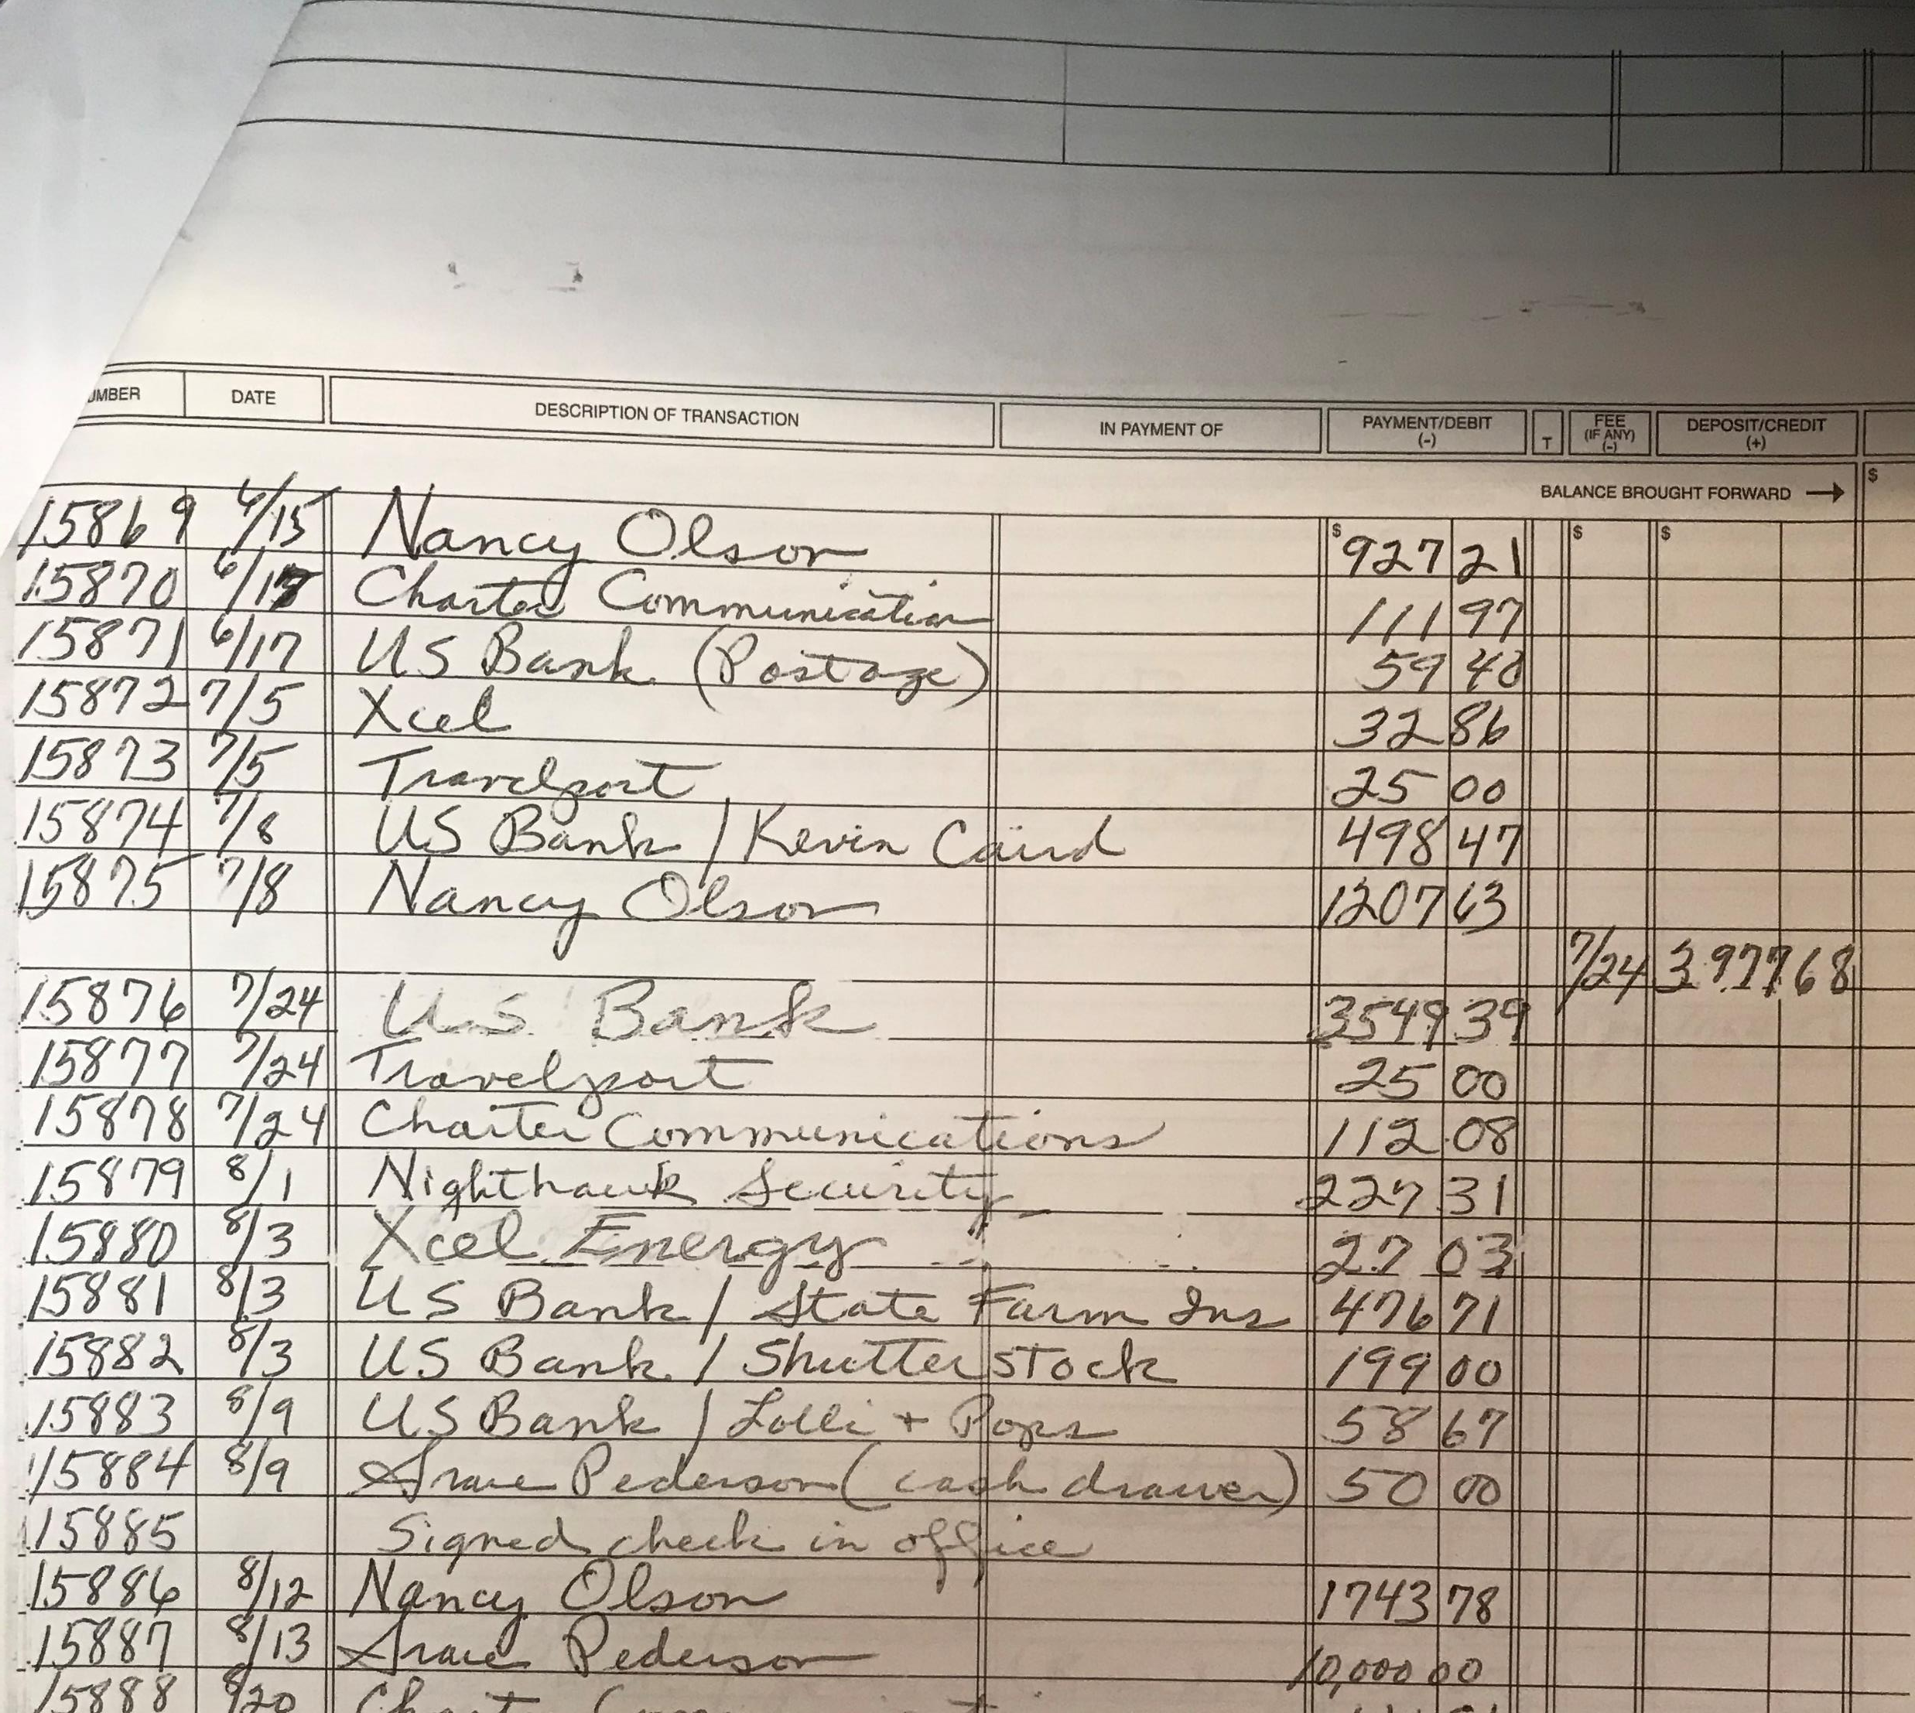
The Old System
All paper
No way to back up
Risk of loss or damage is high
This is one month in 2019 of one category, Imagine over 30 years of data stored this way.

Slide 5
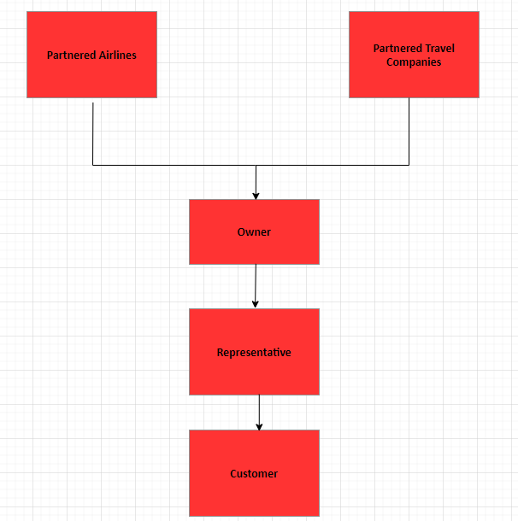
Phase I
Stakeholders
This is a small company so there are not many people employed at the moment
The Partners help The Country Travel Store with deals
Owner gives the Partner’s information to the Representatives
Representatives plan trips with their Customers

Slide 6
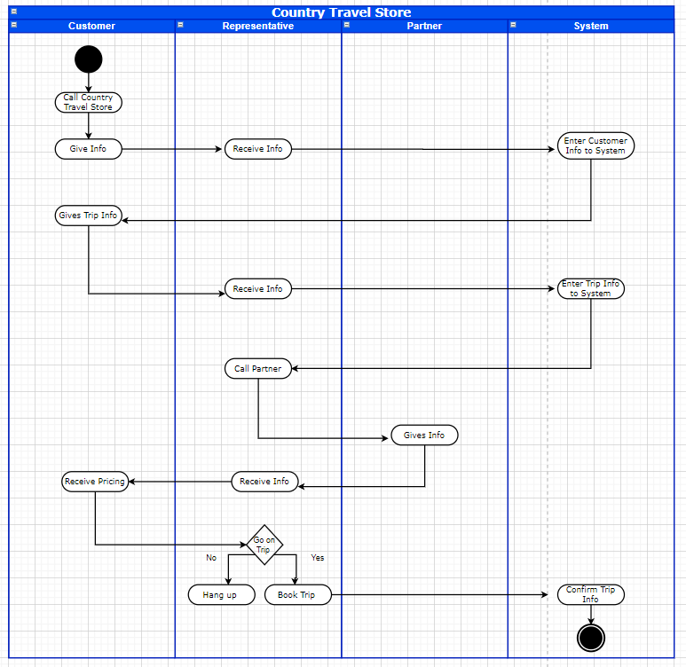
Phase II
Activity Diagram
Shows process of gathering information
Old system requires this all to be written down
This is how they would organize a trip
Needed to write all the information down from customers, partners, and the trip details

Slide 7
Design
The design was also relatively easy. We knew we wanted to get rid of their paper filing system, so we used Microsoft SQL Server to store their data. This way they could access it from most computers through our program. It also has the capability to be backed up, so they have much less risk in losing all their records.

Slide 8
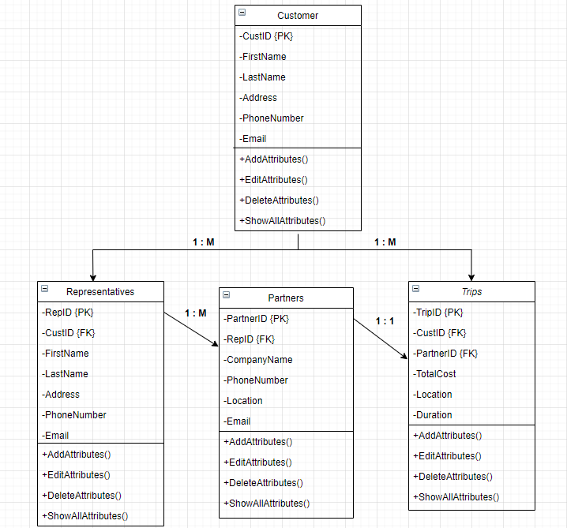
Phase III
Domain Class Diagram
Shows the attributes and methods for our new system
Helped us plan out how to build the system, and how we organized the tables in the database in Microsoft SQL Server

Slide 9
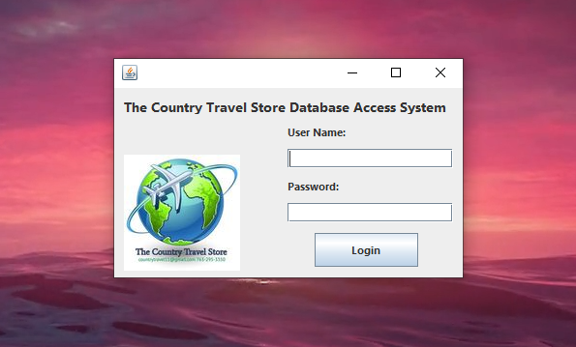
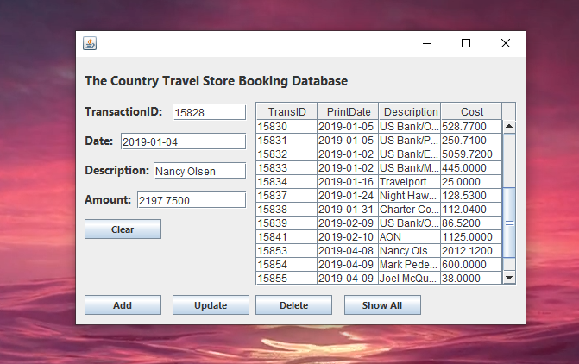
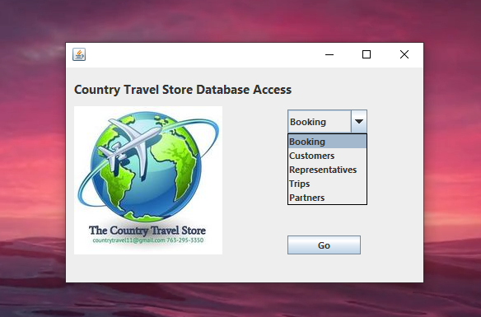
Login
Table Manipulation
Table Selection

Slide 10
The New System
The new system we are going to give The Country Travel Store is a new way for them to store and collect the data they get from customers, trips, partners employees and expenses. This is something they desperately needed and when shown this new system I believe they will be very pleased with it.

